Slide 1
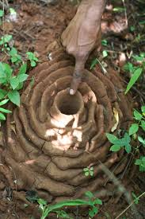
Ant Hill: Pattern In Nature.
By: Jayden

Slide 2
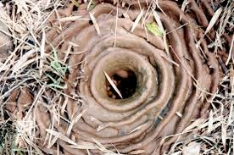
Ant Hills are Patterns in Nature.
This ant hill is made to hold a colony of thousands of ants. This Home has chambers which were the ants can move around from one place to another to get one whatever they need.

Slide 3
InFO ABout Ants.
Ants look much like termites, and the two are often confused.especially by weary homeowners. However, ants have a narrow waist between the abdomen and thorax, which termites do not. Ants also have large heads, elbowed antennae, and powerful jaws for being so small. These insects belong to the group Hymenoptera. This group includes wasps and bees. Ants rank number three for being the most powerful creatures on land.

Slide 4
Ant Hill Presentation Sources.
https://upload.wikimedia.org/wikipedia/commons/thumb/b/b2/Indian_Harvester_Ant_Nest.JPG/2336px-Indian_Harvester_Ant_Nest.JPG
https://upload.wikimedia.org/wikipedia/commons/thumb/b/b2/Indian_Harvester_Ant_Nest.JPG/2336px-Indian_Harvester_Ant_Nest.JPG
http://www.onekind.org/education/top_10_lists/strongest
http://animals.nationalgeographic.com/animals/bugs/ant/

